Slide 1

Course Project
Mohamed mostafa 202000484
Nour Mohamed
202000119
Abdrahman hossam
202001458
Ahmed mostafa 202000896
Begad soliman
202000896
This Photo by Unknown Author is licensed under CC BY-NC

Slide 2
Problem Description
Robotic firefighting systems are designed with certain tasks in mind. These include analyzing and locating fires, conducting search and rescue, monitoring hazardous variables and the primary task of fire control and suppression. Fixed firefighting robotic systems are used in heavily populated and hazardous areas for rapidly extinguishing any threat.

Slide 3
The Problems We Faced
The Bluetooth was not working with the mobile app, so we connected it with the Arduino cable to the laptop and gave it commands with the serial monitor.

Slide 4
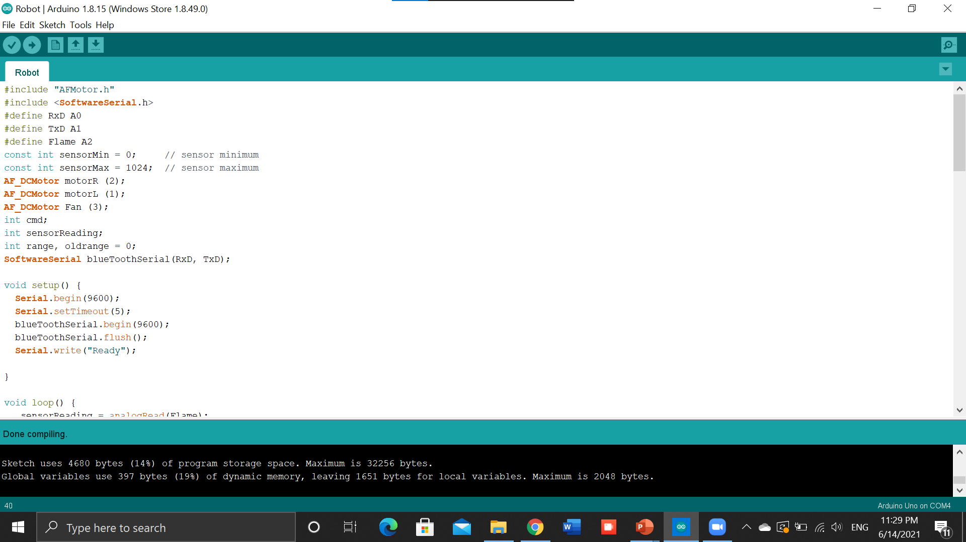

Slide 5
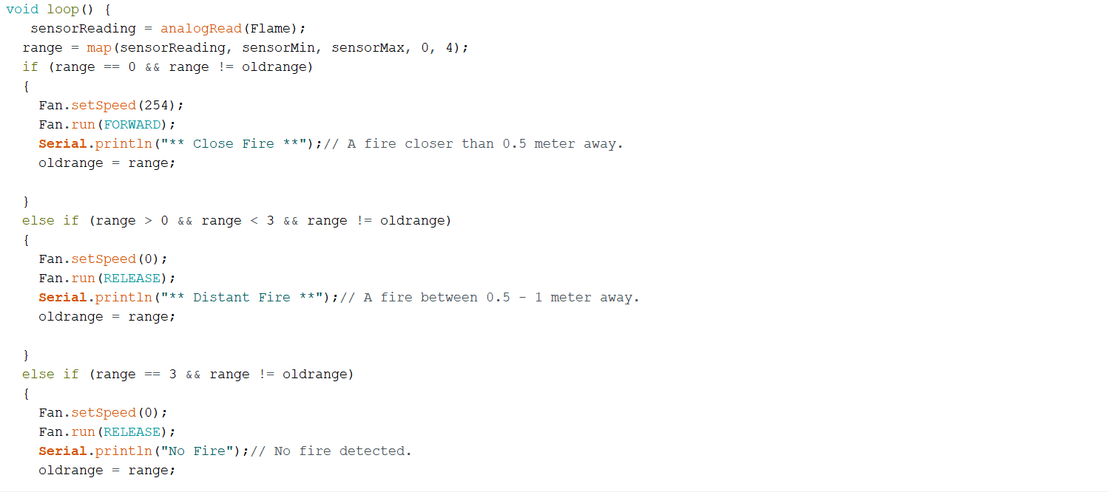

Slide 6
Main components
Arduino
Motor Shield
Lithium battery
flame Sensor
Computer Fan

Slide 7
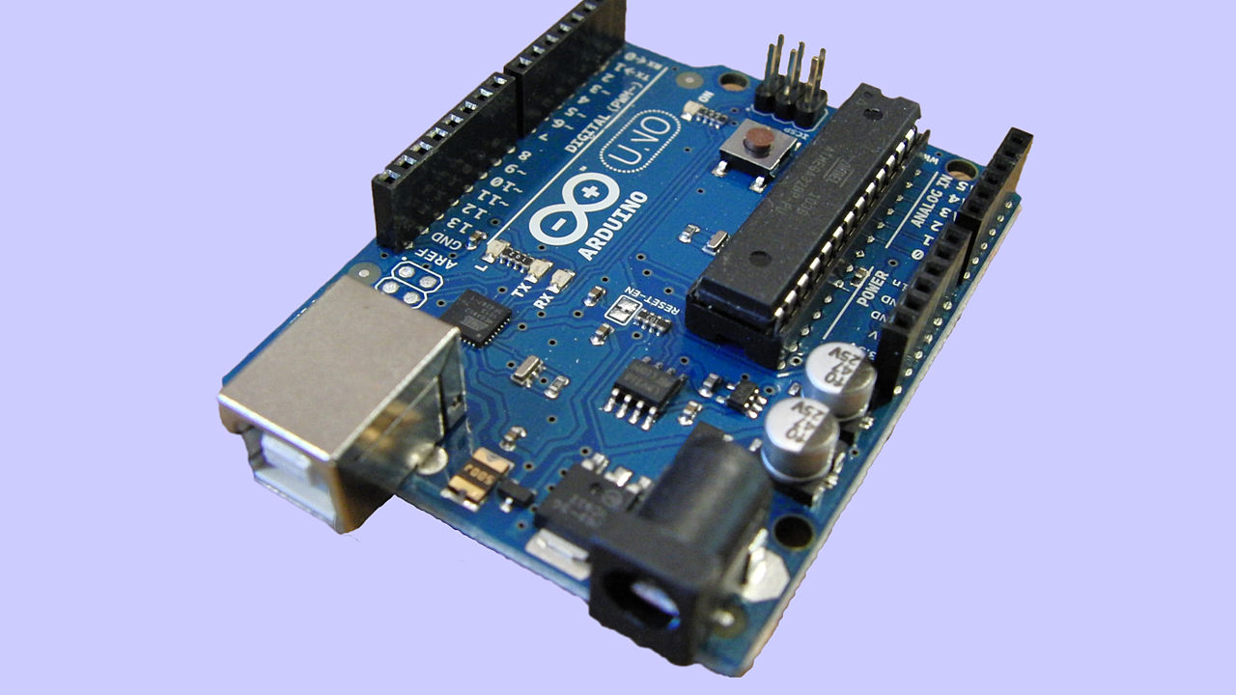
Arduino
An open-source electronics platform or board, as well as the software needed to program it, is referred to as Arduino. Arduino is a platform for artists, designers, enthusiasts, and anybody interested in developing interactive objects or settings to make electronics more accessible. Because the hardware design is open source, an Arduino board may be purchased pre-assembled or made by hand. Users may adjust in any case. Users can customize the boards to meet their own needs, as well as update and distribute their own versions. Changed Words Structural Changes Thesaurus.
This Photo by Unknown Author is licensed under CC BY-SA

Slide 8
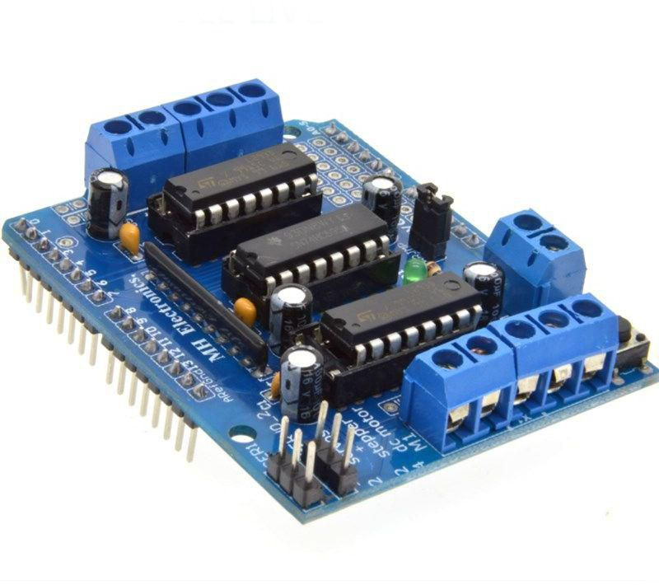
Arduino Motor Shield
The Arduino Motor Shield allows your Arduino to drive DC and stepper motors. It lets you drive two DC motors with your Arduino board, controlling the speed and direction of each one independently. You can also measure the motor current absorption of each motor, among other features.

Slide 9
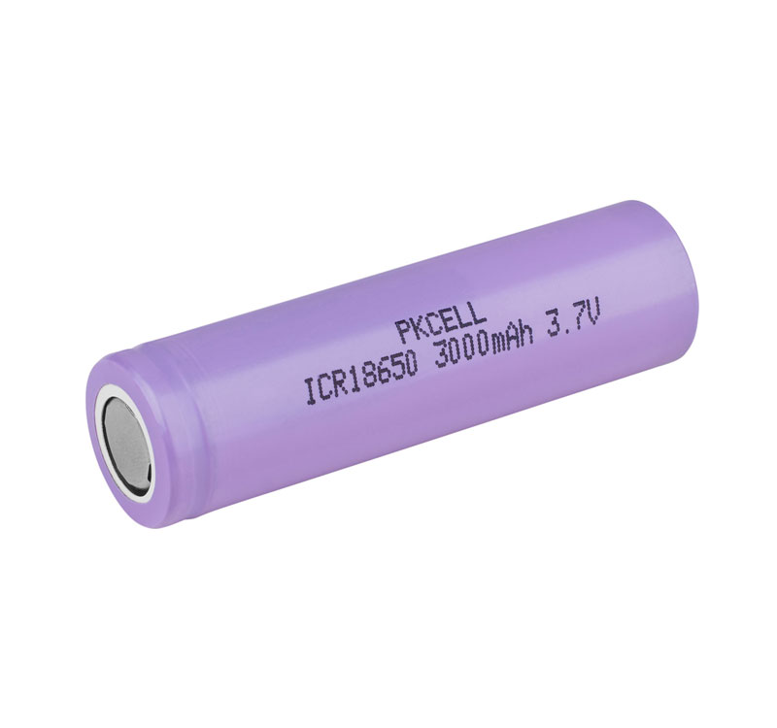
Lithium Battery
A lithium-ion battery or Li-ion battery is a type of rechargeable battery. Lithium-ion batteries are commonly used for portable electronics and electric vehicles and are growing in popularity for military and aerospace applications.
In the batteries, lithium ions move from the negative electrode through an electrolyte to the positive electrode during discharge, and back when charging.

Slide 10
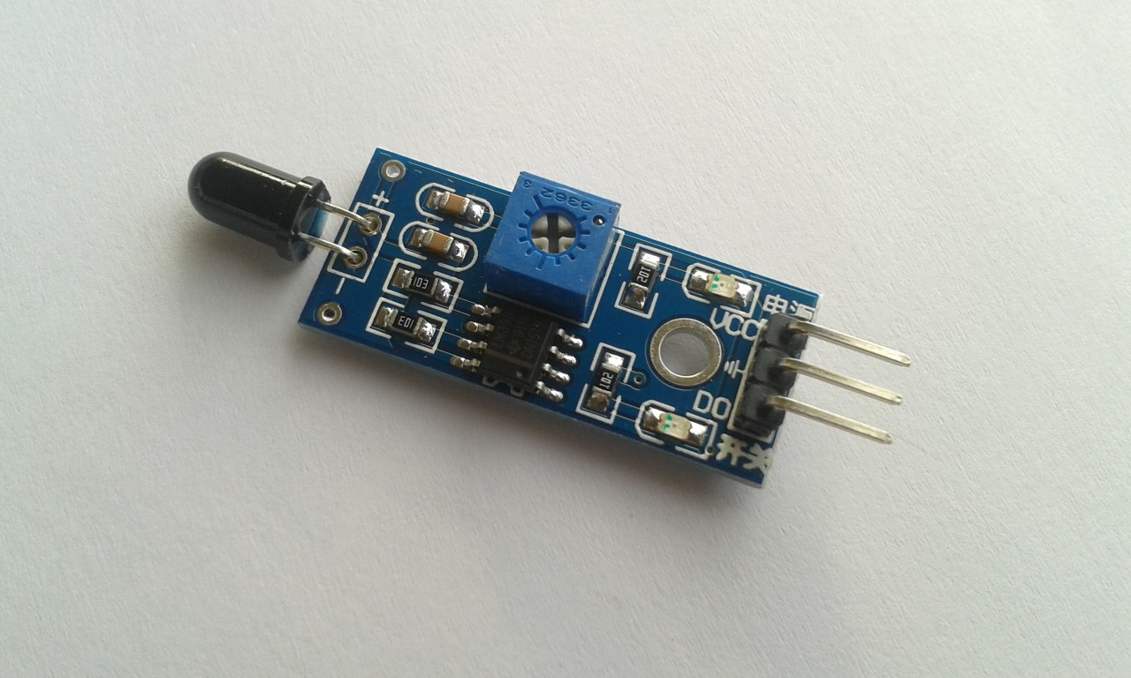
flame Sensor
The flame sensor is a kind of detector, which is mainly designed to detect and respond to the occurrence of fire or flame. The flame detection response may depend on your settings. It includes alarm systems, natural gas pipelines, propane and fire extinguishing systems. This sensor is used in industrial boilers. Its main function is to verify whether the boiler is working properly. Compared to heat / smoke detectors, these sensors respond faster and are more accurate because they have a mechanism to detect flames.
This Photo by Unknown Author is licensed under CC BY

Slide 11
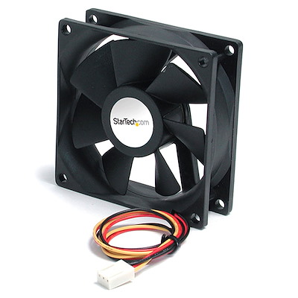
Computer Fan

Slide 12
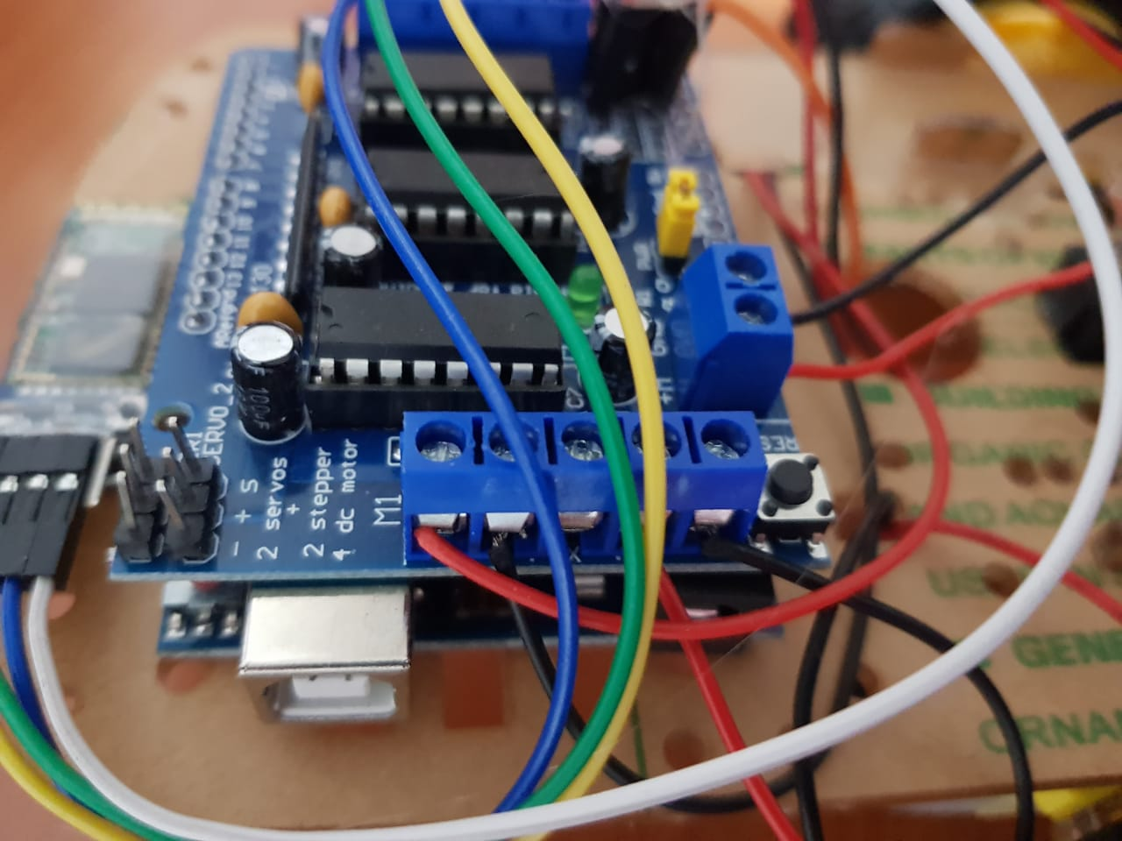
The left car motor is connected to motor 1 in the motor shield
The right car motor is connected to motor 2 in the motor shield

Slide 13
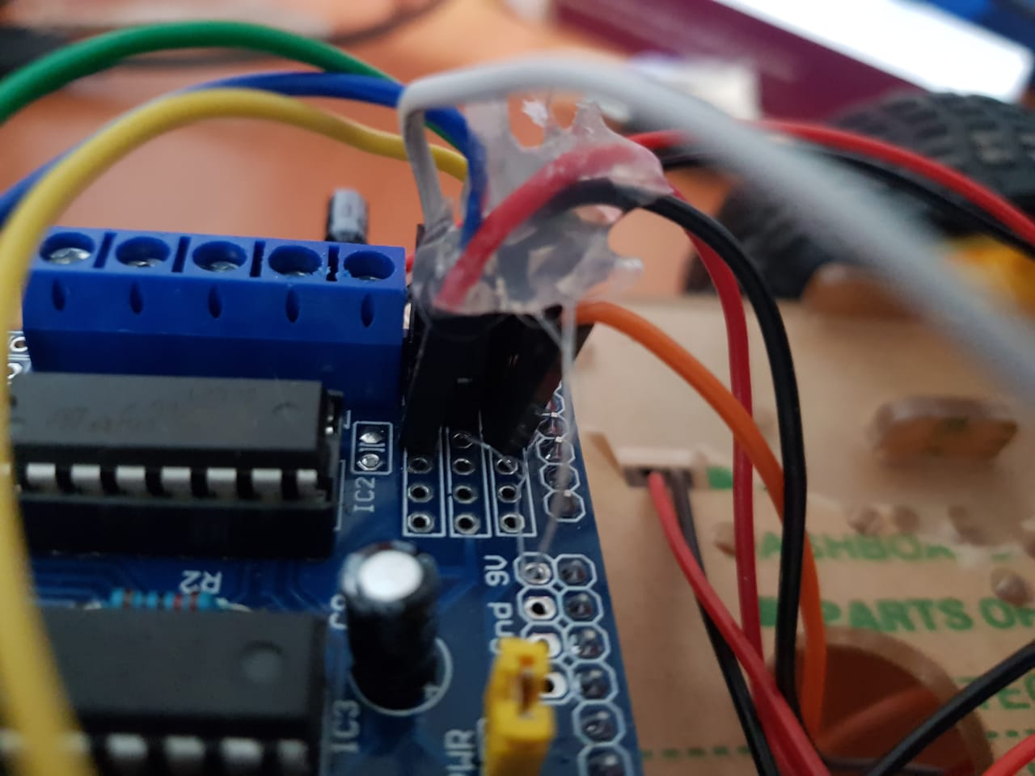

Slide 14
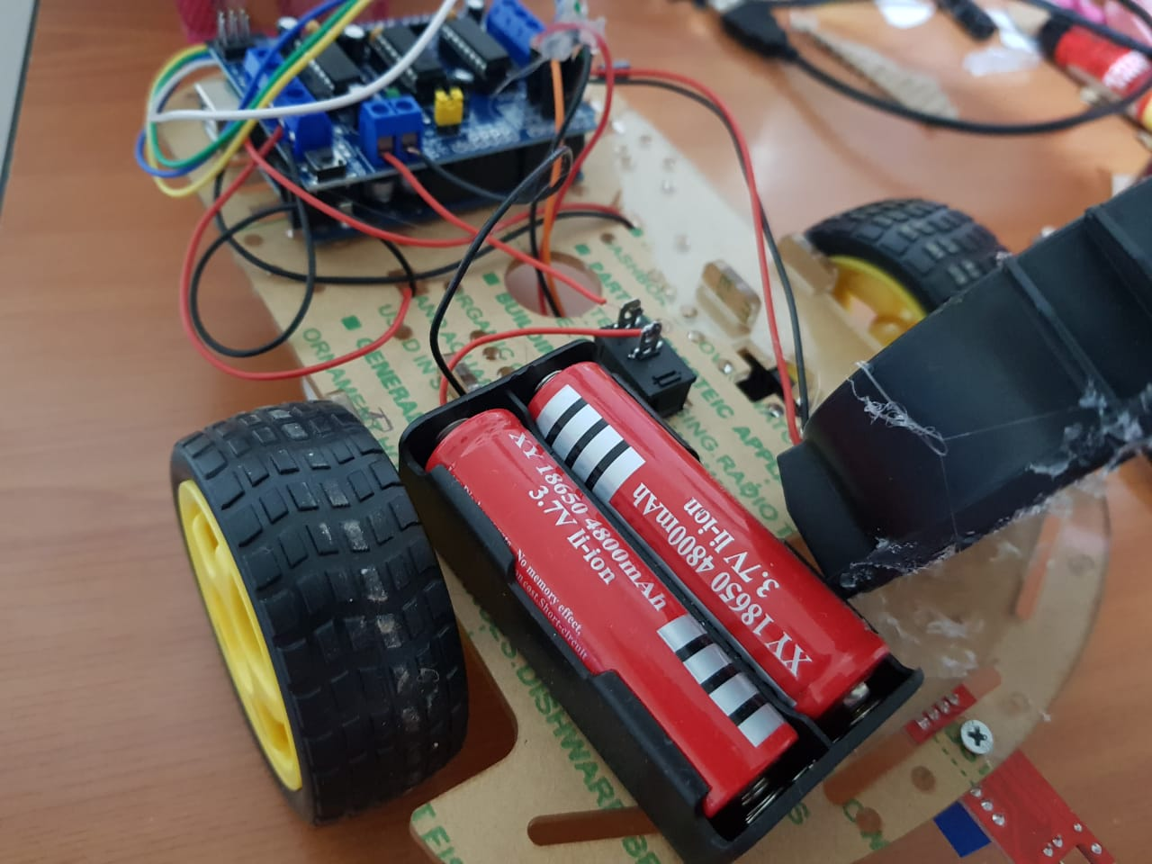
The negative cable in battery is connected to the negative in motor shield and the positive is connected to the button and there is a cable connected from the button to the positive in the motor shield.
The fan is connected to motor 3 in the motor shield and there is a capacitor parallel with it to increase the fan speed.

Slide 15
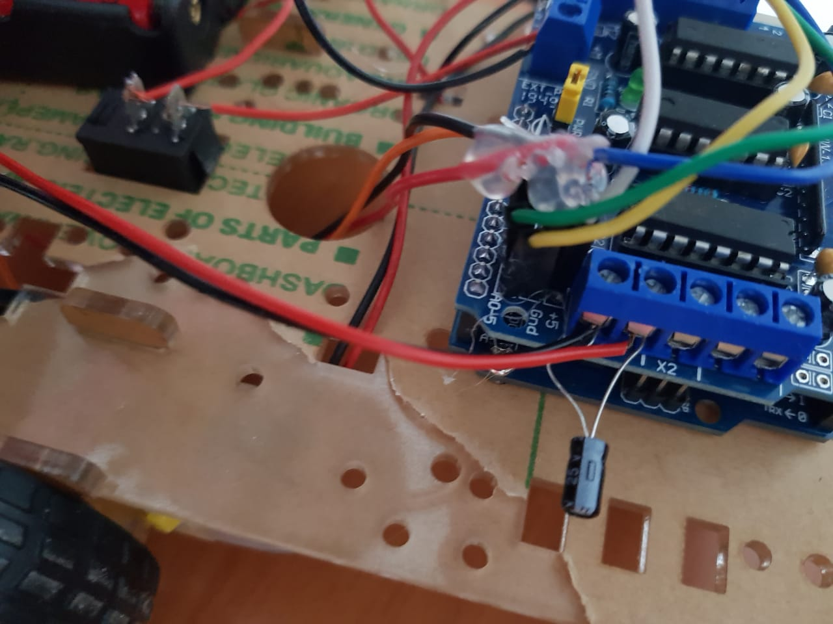
The capacitor is parallel in motor 3 with cables of the fan

Slide 16
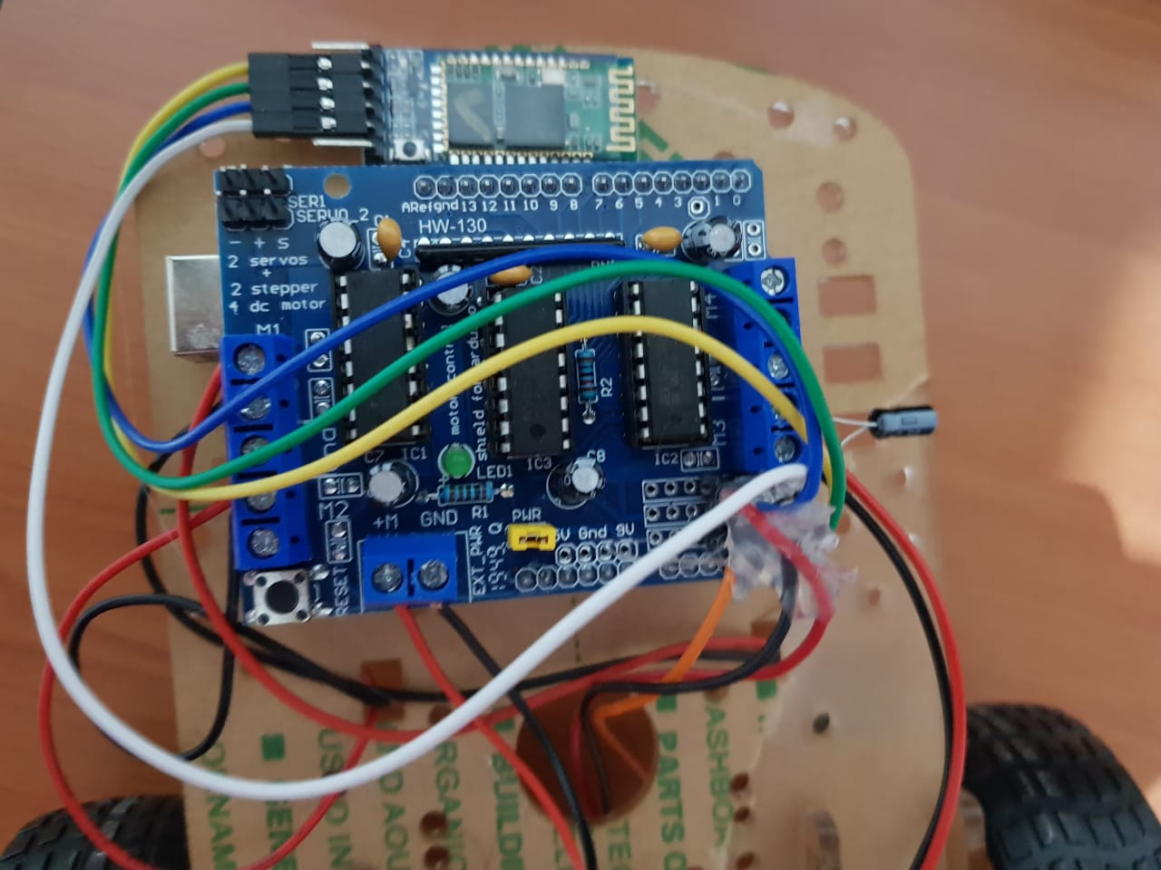

Slide 17
Future Work
We will try to find a solution for the Bluetooth, and we can develop the robot by adding another fan and more sensors. We can also higher the voltage by adding another battery.

